Slide 1
LAB – 09
arrays

Slide 2
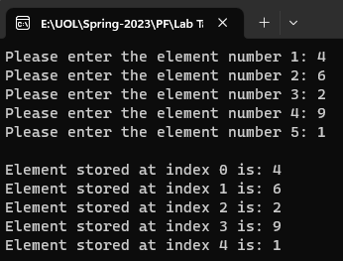
Task - 1
Write a program that contains an array of five elements, take five values from user, assign the value to each element of array and display the all array elements.

Slide 3
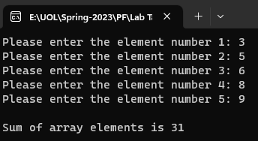
Task - 2
Write a C++ program that adds all elements of array.

Slide 4

Task - 3
Suppose there are two arrays of the same size. Array A consists of five elements while array B in not initialized yet. Write a program that copies the values of A into B. Verify your code by displaying the contents of B.

Slide 5
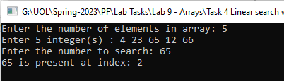
Task - 4
Write a program that takes an integer value from user and search it in array. If found, then display message ‘Number Found’ else ‘Number Not Found’.

Slide 6

Task - 5
Write a Program that finds maximum number in an array.

